Slide 1
AYSO National Referee Program
8U Official Course
For officiating 6U, 7U and 8U games
Notes:
For officiating 6U, 7U, and 8U.

Slide 2
Instructors
Instructor name 1
<badge> Referee
xyz@abc.com
Instructor name 2
<badge> Referee
xyz@abc.com
Instructor name 3
<badge> Referee
xyz@abc.com
Instructor name 4
<badge> Referee
xyz@abc.com

Slide 3
Logistics
Bathrooms: <locations>
Emergency exits: <locations>
Cell phones: Silent and put away

Slide 4
General schedule
Time | Topics
6:00 – 7:20 | Instruction
7:20 – 7:35 | BREAK
7:35 – 9:00 | Instruction
9:00 – 9:35 | Exam and review
9:35 – 10:00 | Conclusion
Notes:
Change as needed.

Slide 5
Major topics
Introduction to soccer and AYSO
Understanding younger players
Referee’s role
Pre-game duties
Starting, stopping, and restarting play
Post-game duties
Referee communication
Notes:
Read through quickly. No need to explain anything.

Slide 6
Introduction to soccer and AYSO

Slide 7
What is the game of soccer about?
A field, a ball, two teams of players
The team with the ball tries to score by kicking the ball into the other team’s goal
Team without ball tries to stop other team from scoring
Notes:
For parents who might not be familiar with soccer.
Before showing the bullet points, ASK: who has seen a soccer match before? ASK a volunteer to summarize the point of a soccer match in 1 or 2 sentences.

Slide 8
Did you know that AYSO is the world’s biggest soccer club?
The American Youth Soccer Organization was established in Torrance, California in 1964 with just nine teams and the dream of bringing soccer to American children.
Sixty years later, AYSO continues to provide programs across the country, making AYSO a model among youth sports programs.
Notes:
AYSO is a National organization with players and Regions all across the country.
Started with about 100 players and now has about 350,000.

Slide 9
AYSO Philosophies
Everyone Plays®
Balanced Teams
Open Registration
Positive Coaching
Good Sportsmanship
Player Development
Notes:
AYSO’s philosophies are what makes us different from other soccer organizations. These are not just nice words or slogans, but they actually state our expectations and how we operate.
(Each philosophy is explained in the following slides.)

Slide 10
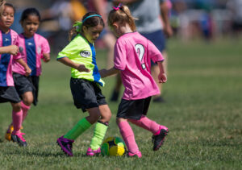
Everyone Plays®
AYSO’s goal is for kids to play soccer, so we mandate that every player on every team must play at least half of every game.
Notes:
Players learn to play soccer by being on the field, not by sitting on the bench. That is why AYSO mandates that every player is required to play at least half a game.
Source: AYSO National Rules & Regulations
(Some regions increase the requirement to three-quarters of a game.)
If there is a question on an exam about this, the answer is half a game.

Slide 11
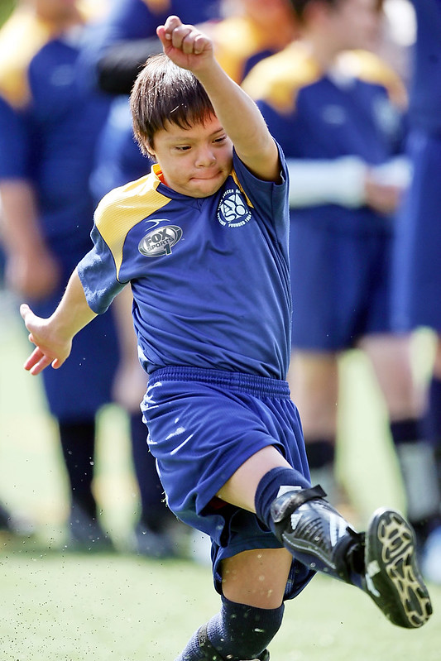
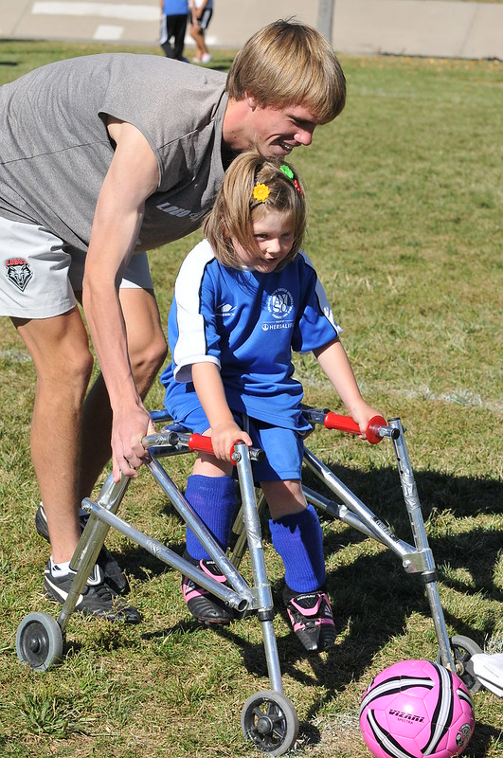
Everyone Plays®
Everyone Plays In our Communities
Notes:
The idea of “everyone playing” also applies to persons with physical or mental disabilities. This can be seen in AYSO’s EPIC program. EPIC stands for Everyone Plays In our Communities. Players who need help on the field have “buddies” with them. Buddies are typically youth players who have been trained to perform this role.

Slide 12
Balanced Teams
Each year we form new teams as evenly balanced as possible, providing a stronger learning experience for teams as they play teams comprised of similar ability.

Slide 13
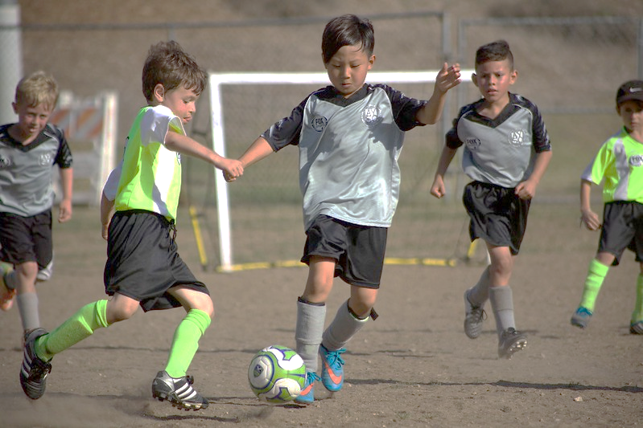
Open Registration
Open to all children between 3 and 18 years of age who want to register and play soccer. Interest and enthusiasm are the only criteria for playing.
Some regions have EPIC programs that provide a quality soccer experience for those with physical or mental disabilities.

Slide 14
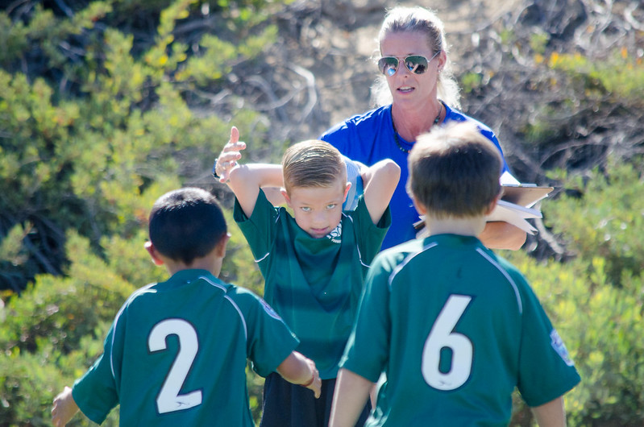
Positive Coaching
AYSO requires coaches to create a positive experience for every player in AYSO.
Encouraging players’ effort leads to greater enjoyment, improved skills and stronger motivation in players.
P
OSITIVE
I
NSTRUCTIONAL
E
NCOURAGING
Notes:
AYSO believes that encouraging players is the best way to help them be better motivated, better skilled, and get the most enjoyment.
We expect coaches to be positive in all their interactions with players.
A way to remember how coaches are to behave is in the acronym PIG.
Background: The idea of PIG came directly from wording in the AYSO National Rules & Regulations, but the wording has been modified and now says: “It shall also be the duty of each coach to: ...Limit his/her sideline participation during AYSO matches to comments that are positive and/or encouraging, with limited supportive instruction.”

Slide 15
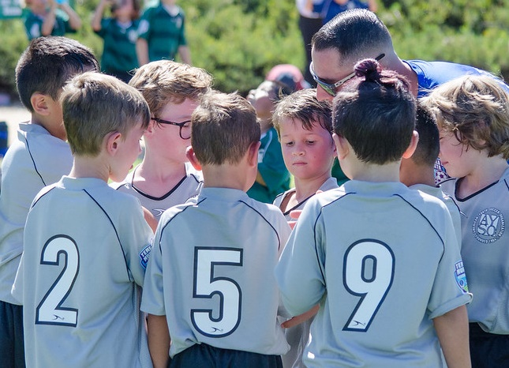
Good Sportsmanship
We strive to create a positive environment based on mutual respect rather than a win-at-all-costs attitude, and our programs are designed to instill good sportsmanship in every facet of AYSO.
Notes:
All AYSO participants are expect to show respect, regardless if they have won a game or lost a game. Everyone deserves to be treated with respect, no matter what role they play. This includes coaches, players, spectators, and referees.

Slide 16
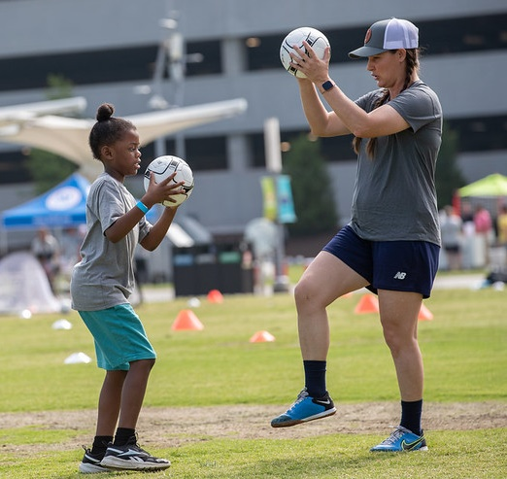
Player Development
All players should be able to develop their soccer skills and knowledge to the best of their abilities, both individually and as members of a team, in order to maximize their enjoyment of the game.
Notes:
AYSO expects that we should help players to become better, whether a player is 6 years old or 16 years old.

Slide 17
AYSO Team
Notes:
Before showing the triangle, DISCUSS...
When you show up at a soccer match, you’ll see the two teams of players. Who else is there?
SHOW THE TRIANGLE
There is also an invisible team at every soccer match, a team that AYSO calls the “AYSO Team.” It consists of coaches, parents, and referees. The members of the team work together to assure that players have the best time at a game.
ASK and discuss:
At a game, what is the role of a coach? Role off the parents? Role of the referee?
A common saying is: “The coaches coach, the refs ref, and the parents cheer.” Then the kids will have the best time.
TRANSITION TO NEXT SLIDE:
What are rules that can help the AYSO Team function best?

Slide 18
AYSO Team rules
Work together
Help each other
Protect each other
Do your best
Know your role
Notes:
Here are things that can help the AYSO Team function well. (No need to explain, except for “know your role.”)
KNOW YOUR ROLE:
Each team member has a certain role. Coaches have a certain role: PIE: Positive, Instructional, Encouraging. Parents have a certain role: cheer. And referees have a certain role: enforcing rules to ensure the game is safe, fair, and fun.
What happens if a coach or parent starts doing the referee’s job, especially if they criticize the referee’s decisions? DISCUSS. Confusion, chaos, disrespect.
Referees have the added job of helping coaches and parents stick to their roles.

Slide 19
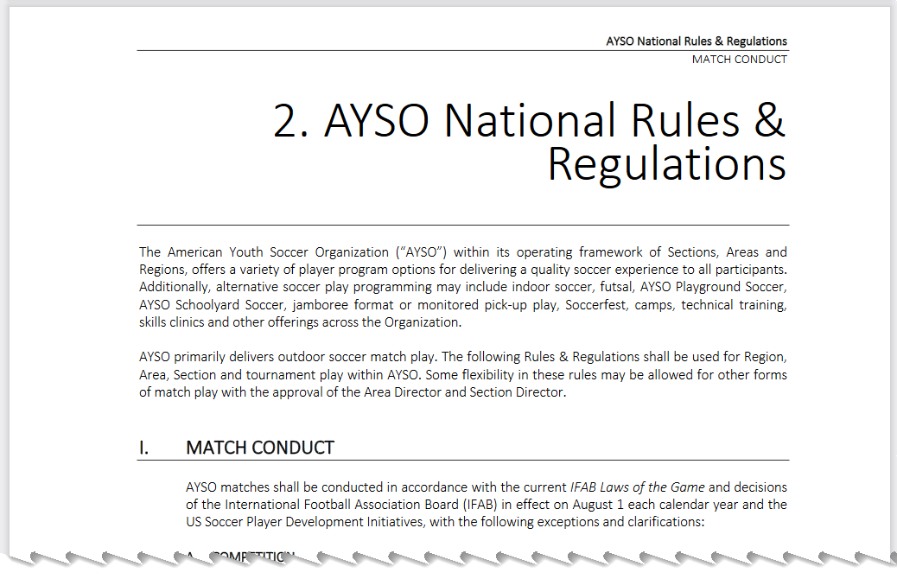
Rules used by AYSO
International Football Association Board (IFAB) Laws of the Game
theIFAB.com
PDF and mobile app
AYSO National Rules & Regulations
aysovolunteers.org
within “AYSO Reference Book”
Notes:
WHY: Students need to know that AYSO is not making up the rules.
STATE: We use the same rules used throughout the world, but simplify them because we are working with youths, including many who have never played soccer before. The rule book is called the “Laws of the Game”; it contains what it calls “Laws.”
BACKGROUND: AYSO rule variations are documented in the AYSO National Rules & Regulations. See the next slide for examples. Many variations are also documented in the “Small-sided matches” section of the AYSO Reference Book.

Slide 20
Rule simplifications for younger players
Smaller fields
Smaller balls
Smaller goals
Fewer players on the field (“small-sided games”)
Shorter halves
Notes:
Cover quickly. No need to explain anything.

Slide 21
Understanding younger players

Slide 22
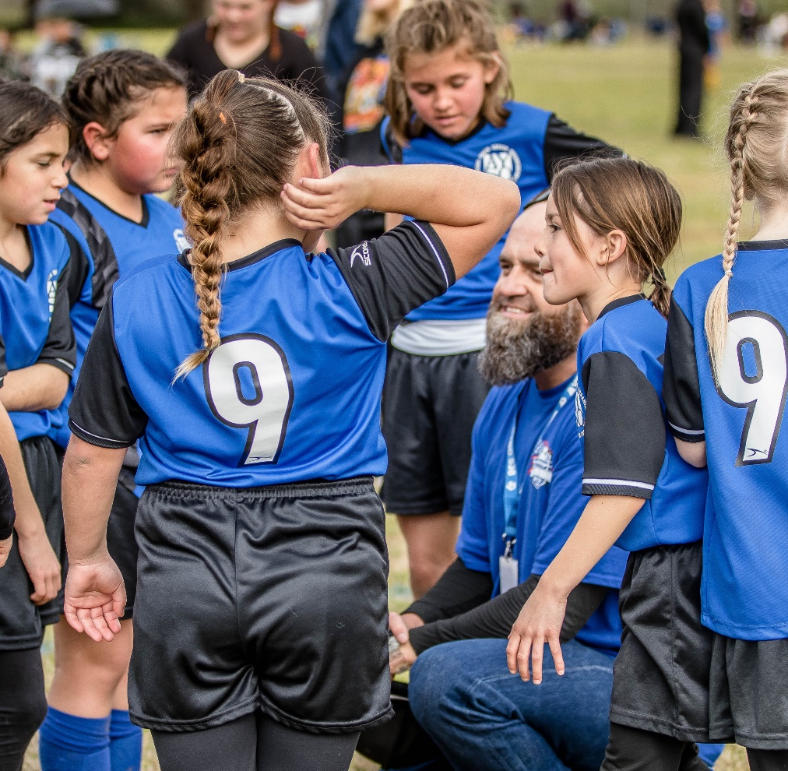
Know your audience
About 6–8 years old
Knowing audience provides context as to how to officiate games

Slide 23
6U Players
Motor skills are still developing
Lots of energy, but in bursts
Can’t sit still long
Craves praise and attention
Fearful of unknowns
Rapid and unpredictable mood changes
Disposition to telling tall tales
Lacks judgment regarding own safety/abilities
Asks lots of questions
Notes:
For this slide and the next, ask questions of the students (many or most of whom are parents of 6-8U players):
Examples:
How coordinated are 6 year olds?
What’s their energy like? High? Low?
What’s their attention span?
What are their moods like?
How aware are they of their own safety and abilities?

Slide 24
8U Players
Eye-hand coordination has improved
8U can now balance on one foot
Friendship is important
Afraid of failure
Starting to compare self to others
Self-esteem and self concept a big issue
Quick to tattle
Starting to grasp the Team concept
Treats every little mistake as a major crime
Notes:
How different are 7-8 year olds compared to 6 year olds?

Slide 25
Younger players in general
Soccer experience
Physical skill
Endurance
Self-awareness
Sense of fairness
Enthusiasm
Notes:
Our audience is 6-8 year olds who are in their early years of development.
They have little to no experience playing soccer—they are not professional soccer players! They certainly don’t know the rules.
They have limited physical skills
Their endurance is limited
They have limited self-awareness of their physical abilities
Their enthusiasm can go up and down and is limited.

Slide 26
Referee’s role

Slide 27
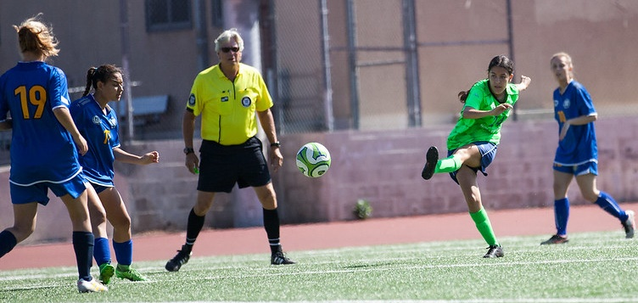
Job of Referee
Enforce the Laws of the Game as applied to 6-8U games. The decisions of the referee are final.
Is the official time-keeper.
Notes:
The job of a referee can summarized in 3 words:
First, their job is to assure the game is SAFE.
Second, they assure the game is FAIR by enforcing rules.
If the game is safe and fair, the players will have the best chance of having FUN.

Slide 28
Job of Referee
Enforce the spirit of the Laws of the Game, which is summarized in three words:
Safe Fair Fun
Notes:
The job of a referee can summarized in 3 words:
First, their job is to assure the game is SAFE.
Second, they assure the game is FAIR by enforcing rules.
If the game is safe and fair, the players will have the best chance of having FUN.

Slide 29
Job of Referee
Emphasis is “Safe, Fair, Fun," especially in younger players' games, rather than getting wrapped up in technicalities.
Unique to soccer, referees are advised to ignore trifling or doubtful offenses.

Slide 30
Characteristics of a Referee for younger players
Friendly
Instructive
Helpful
Encouraging
Patient
Notes:
NOTE: do not show the bullet points until after the following discussion:
ASK and discuss: What our audience in mind (what was discussed on previous slides—especially that they know little or nothing about soccer), what kind of referee would be helpful for these players?
After showing the bullet points...conclude by saying:
Referees need to be friendly and helpful teachers.
If play is not safe or fair, stop play and give a quick explanation (no lectures)
Then quickly get play moving again.
Referees need to be patient because they are going to have to explain the same thing many times during a game.

Slide 31
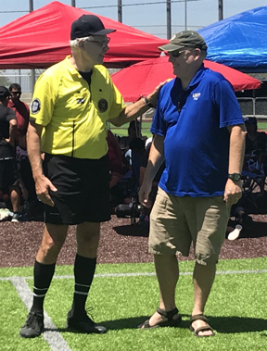
Dealing with coaches and spectators
Use the AYSO Team concept to enlist cooperation
Remain calm and professional
Maintain control of your emotions
Intervene early to prevent escalation (a smile, wink or look can defuse a bad situation)
Keep adults focused on creating an enjoyable experience for players
Notes:
Soccer can be a competitive sport. Sometimes when coaches and parents get into competitive situations, their enthusiasm gets out of control and becomes negative.
The job of the referee is to bring enthusiasm/emotions back to positive levels and to refocus everyone on the game so the kids can have fun.
DEALING WITH COACHES:
“Hi coach, your job today is to coach. Please let me make the calls on the field. Can I get your cooperation? Thank you.”
DEALING WITH SPECTATORS:
If spectator behavior needs changing (is negative, especially if critical of the referee’s decisions), suspend the game and ask the coach to address it.
BOTTOM LINES:
Get everyone refocused on enjoying the game.
Do not allow yourself to be criticized or abused. Deal with issues early so they don’t become bigger.

Slide 32
Pre-game duties and activities

Slide 33
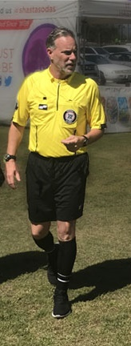
Arrive early
At least 20 minutes prior to game time
In proper uniform
Notes:
Explain what uniform will be provided.
If an official uniform will be provided, explain the parts: shirt, shorts (black), socks (2-stripe), AYSO badge.
Referees will need to provide their own shoes. All or mostly black is the standard. Wear something comfortable.

Slide 34
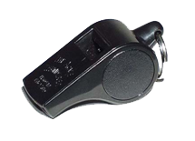
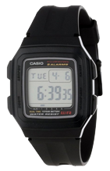
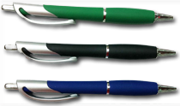
Have required equipment
Notes:
DISCUSS:
What equipment will be provided? Typically: a flipping coin, a whistle. If the Region requires record-keeping, also a game wallet (show and explain how used).
What equipment will the referee need to provide? Typically: a digital watch (a cell phone is not practical), pen or pencil for record-keeping.

Slide 35
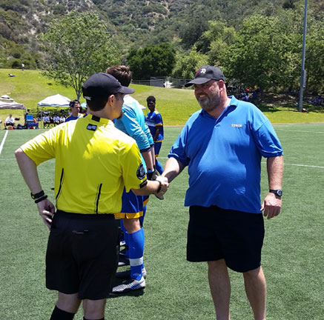
Meet coaches
Introduce yourself
Learn their names
Be friendly
Notes:
Coaches are part of the AYSO Team.
Start a positive relationship with them by meeting them before the game. Get their names so you can call them by name later in the game.

Slide 36
Goal line
Field of play for 6–8U
Halfway line
Goal
Center mark
Touchline
Notes:
The center mark is used for kick-offs. If no center mark, just approximate. Exact location not critical.
Note: no corner flags, no goal areas, no penalty areas or arcs, no center circle, no corner arcs.

Slide 37
Field of play for 6–8U
Field set-up may vary by Region depending on how the Region runs 6–8U games.

Slide 38
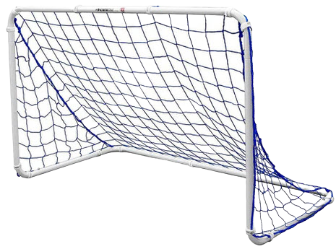
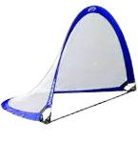
Inspect field and equipment
Markings
Holes, glass, rocks, debris, etc.
Goals
Ball
Notes:
Are markings adequate?
Is the field is safe?
Are larger goals (4 x 6 foot opening) anchored or weighted down? Don’t start game until they are.
Is the ball is safe? See next slide.

Slide 39
Pre-game duties and activities
Inspect ball
Spherical and safe. Not torn, no rough edges, no protrusions.
Firm, but yields about ¼ inch to thumb pressure
Size 3
Notes:
Need a least one ball. Can also get two extras, one at each end of the field next to the goal but away from the goal line.
A convenient time to get the balls is during the player inspections. Balls are typically provided by the home team, but if needed can be provided by the visiting team.
Side note: Size 4 is used for 10U and 12U. Size 5 is used for 14U and older.

Slide 40
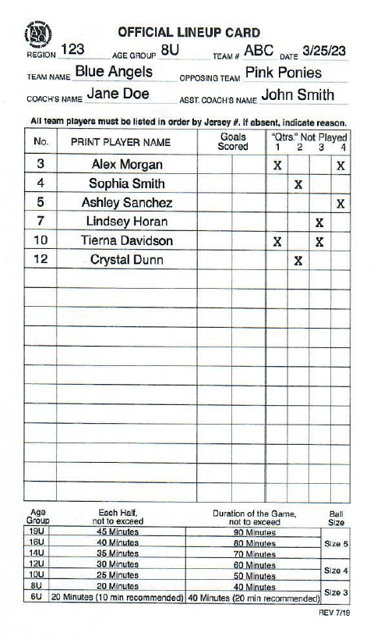
Get lineup card
One from each coach
During game:
Note goals scored
Note players out in each “quarter”
Notes:
Use lineup cards as dictated by each Region. It is the official record of the game, including the teams, the players, who scored goals, and which players did not play in each quarter. The last is needed to confirm that each player played at least 2 “quarters,” as required by AYSO.
A convenient time to ask for the card is when you inspect the players for each team.
Ask who is the home team. This is also a good time to ask the home coach for three game balls.

Slide 41
Inspect players
Shirt, Shorts, Socks
If player is missing a uniform piece, let them play but remind them to bring it next time
Shoes
Must wear safe closed-toe shoes — soccer or athletic shoes are both fine
Shinguards
Required
Must be completely under socks (may not roll sock over shinguard)
Notes:
Five S’s: Shirt, Shorts, Socks, Shoes, Shinguards
Go to coach of one team and ask to inspect the players. If lineup cards are used, ask the coach for it. If this is the home team, ask for three game balls.
Have the players line up.
Introduce yourself.
Look at the players to see if they have the required five S’s. Ask or state: “Who has shinguards on?” (Ask them to tap on them). “Make sure all jewelry is off—check your ears, neck, wrists, anything hard in your hair” (of course, the referee must be looking at same). SEE NEXT SLIDE FOR MORE ON PLAYER INSPECTION.
Thank the players and wish them a good game.
SUGGESTION: if there is time, do a quick demo of how to do a player inspection.

Slide 42
Inspect players
No casts or splints (even if padded) – casts and splints may NOT be removed in order to play
Knee braces are okay, but only if padded and safe to all players (in your opinion)
No jewelry of any kind – this includes necklaces, earrings, bracelets (including friendship bracelets), anything hard sticking out in the hair (AYSO has exceptions for beads), etc. No taping over jewelry.
Notes:
May 2023: New AYSO policies about beads and medical devices. In brief, beads that are close to the scalp, or are part of a bundle of hair that has limited capability of flying around, are ok. Beads that are away from the scalp, like at the ends of long braids, are not ok.
Quote from AYSO National Rules & Regulations:
F. Players shall not wear anything that is dangerous to either themselves or other players subject to the referee’s approval under Law 4 of the IFAB Laws of the Game. AYSO, in accordance with permitted modifications for youth games, allows the following:
• Hair Beads and Clips
Hair control devices and other adornments, such as beads, worn in the hair must meet the following criteria:
‐ Be securely fastened to the head.
‐ Do not present an increased risk to the player, teammates, or opponents.
‐ Flat clips less than two inches in length may be used to hold the hair in place close to the head so long as their placement on the head does not present an increased risk to the player, teammates or opponents.
‐ Hair charms are still considered jewelry and are not permitted.
• Medical Devices
If the device is needed to restrict mobility, protect an injury or support proper alignment to expedite the healing process of a temporary injury and is hard (cast, splint, etc.) then it is not allowed. If, on the other hand, the protective device is used to provide support, flexibility or enable an otherwise healthy player to function normally such as a knee brace, prosthesis, hearing aid, insulin pump/monitor, etc. then this would be allowed provided the device was
sufficiently padded to prevent injury to other players. The Laws of the Game specify that “A player must not use equipment or wear anything that is dangerous.”
The Referee is the sole judge of whether or not the individual item in question is permissible to
wear in the game.

Slide 43
Inspect players
Medical alert bracelets allowed but must be secured to player with tape, cloth wristband or something similar that is safe. The information must remain visible.
Nothing dangerous in opinion of Referee

Slide 44
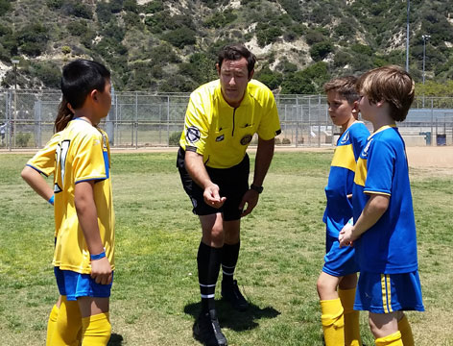
Conduct coin toss
Call for captains
Brief introductions (no lectures)
Referee picks a captain to call the coin toss. Tosses the coin.
Winner of coin toss chooses either which goal to attack OR to kick off
Notes:
Purpose of coin toss: to decide which team kicks off first to start the game.
Coin toss typically is done at the center mark. (Could also be done at a touchline if both teams are there.)
Call for captains (“Could we have captains, please”). At least one from each team, but can be more than one.
Have captains introduce themselves to each other.
Show the coin to captains, indicating which side is heads, which side is tails.
Pick a captain to call the toss (TRADITIONALLY, the visiting captain.) Ask the calling captain to decide heads or tails.
Flip the coin and announce the result.
Ask the winning captain what their choice is: which goal to attack OR kick off. Write down the conclusion so you’ll remember, especially for the 2nd half when teams switch sides.
Ask the coaches to get their players on the field for the kick off.
SUGGESTION: if there is time, do a quick demo of the above process, using two students as captains.

Slide 46
How many Philosophies does AYSO have?
Six
Name the six AYSO Philosophies.
Everyone Plays
Balanced Teams
Open Registration
Positive Coaching
Good Sportsmanship
Player Development

Slide 47
What acronym is used to describe how coaches are to behave with their players?
PIE
What does PIE stand for?
Positive
Instructional
Encouraging

Slide 48
Who are the 3 members of the AYSO Team?
Parents – Coaches – Referees

Slide 49
What three words embody the spirit of the Laws of the Game?
SAFE FAIR FUN

Slide 50
According to the AYSO National Rules & Regulations, what is the minimum amount of time each team member must play?
Half the game (two “quarters”)

Slide 51
How to start the game

Slide 52
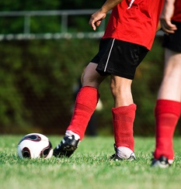
Kick-off
To start each half
After a goal is scored
Notes:
The results of the coin toss determines who kicks off in the first half.
For the second half, teams switch ends of the field.
The team that did not kick off to begin the first half will kick off to begin the second half.

Slide 53
Kick-off
Verify correct number of players on field (no visible or audible counting).
6–8U games:
4 v 4, no goalkeeper
Notes:
Explain how to count players with “no visible or audible counting.”
Explain what “4 v 4” means.

Slide 54
Kick-off
All players on own side—except kicker
Defenders at least 5 yards from ball
A
D
D
A
D
A
D
A
Notes:
Help players to be in allowed positions.
The kicker can be in the opponents’ side of the field for the kick-off.

Slide 55
Kick-off
Ball stationary on center mark
Referee blows whistle to start play
Ball in play when kicked and clearly moves
A goal can be scored directly against opponents
Kicker cannot play ball second time until ball touched by another player

Slide 56
Keeping time
Time officially starts when ball has been put into play.
Match divided into two equal halves:
6U — 10 minutes each (20 minutes total)
7U — 20 minutes each (40 minutes total)
8U — 20 minutes each (40 minutes total)
Clock runs continuously through each half.
Half-time: 5–10 minutes
Notes:
Talk about practicalities of starting watch:
Assure watch timer is ready
Start timer and assure it is working
Blow whistle to start the half
Length of half-time might be dictated by a Region, e.g., 5 minutes (not 10).

Slide 58
True or False
It is not necessary to check the field prior to the start of the match if it is the last game of the day.
False

Slide 59
During the field inspection, the Referee notices that a goal is being held in place by two bricks placed on the back of the structure. What should the Referee do?
Bricks resting on the goal structure are not sufficient to anchor it securely. The Referee should inform the coaches that the goals need to be securely anchored before the match can start.

Slide 60
During the safety inspection of the players, the Referee notices that a player is wearing earrings. The player explains that their ears were pierced the previous day and if the earrings are removed the holes will close.
What should the Referee do?
The Referee should explain to the player that earrings are not permitted; if they wish to play, the earrings must be removed. The Referee may choose to involve the coach.

Slide 61
The team that wins the coin toss chooses ____ ?
Either which goal to attack
OR
to kick off

Slide 62
Where should the players be on a
kick-off?
Each team must be in its own half of the field—except the kicker.
The team that is not taking the kick-off must be at least 5 yards from the ball.

Slide 63
Stopping the game

Slide 64
When does play stop
Play stops naturally when:
Ball obviously leaves field, including when goal is scored

Slide 65
When does play stop
When the Referee stops play (blows whistle):
Ball leaves field or goal scored, but players keep playing
Foul / technical offenses
Injury
Substitution
Outside interference
Time expires (each half)
Notes:
BACKGROUND
The typical “technical offense” in a 6-8U game would be a “double touch” offense—when the player who put the ball into play touches it a second time before another other player touches it. Don’t discuss details here because restarts have not yet been covered.

Slide 66
Ball leaves field
The ball’s position determines whether it is in or out of play
Not the player’s position

Slide 67
Ball leaves field
Lines of field are part of
area they define
In play
IN
In play
Touchline or goal line
OUT
Either in air or on ground
In play
Out of play

Slide 68
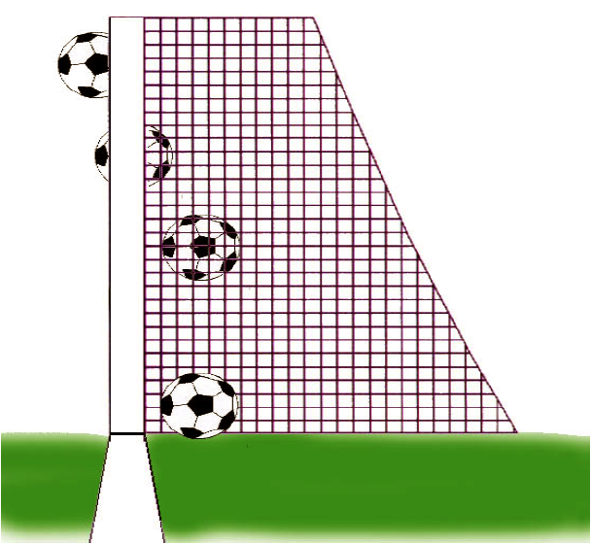
Goal is scored
What is a goal?
When whole ball crosses over whole goal line, between goalposts and beneath crossbar.
It does not matter which team put it there.
Notes:
A team can score against itself...called an “own goal.”

Slide 69
Foul committed
Common in 8U and younger age groups:
Kicking an opponent
Tripping an opponent
Pushing an opponent
Holding an opponent
Handball (deliberate)
Playing in a dangerous manner
Notes:
Explain and demonstrate each in limited detail. Handball will need more detail. Same for dangerous play.
EXPLAIN: cannot score goal from an accidental handball (Law 12).
EXPLAIN: Referees should not interfere with the fun of the game by stopping for doubtful or trifling offenses

Slide 70
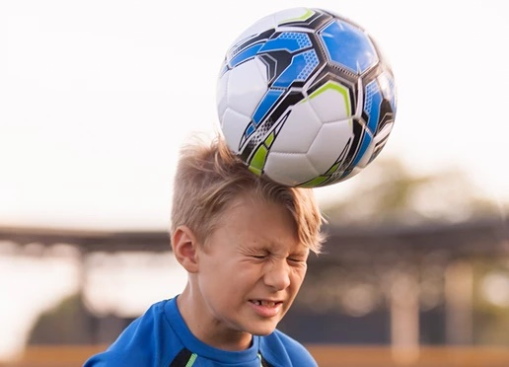
Technical offense
AYSO safety rule
Players at 12U and below may not deliberately head ball
Notes:
Instructor Notes
AYSO bans DELIBERATE heading for all 11U and below division players. If an AYSO program doesn’t have single age divisions, heading is banned for 12U and below.
The sanction is an indirect free kick taken from the place where heading took place...to be explained later when discussing Restarts.

Slide 71
Technical offense
“Double touch” rule
Player who put ball into play cannot touch it again until touched by any other player
Notes:
The sanction, indirect free kick, will be covered later when discussing Restarts.

Slide 72
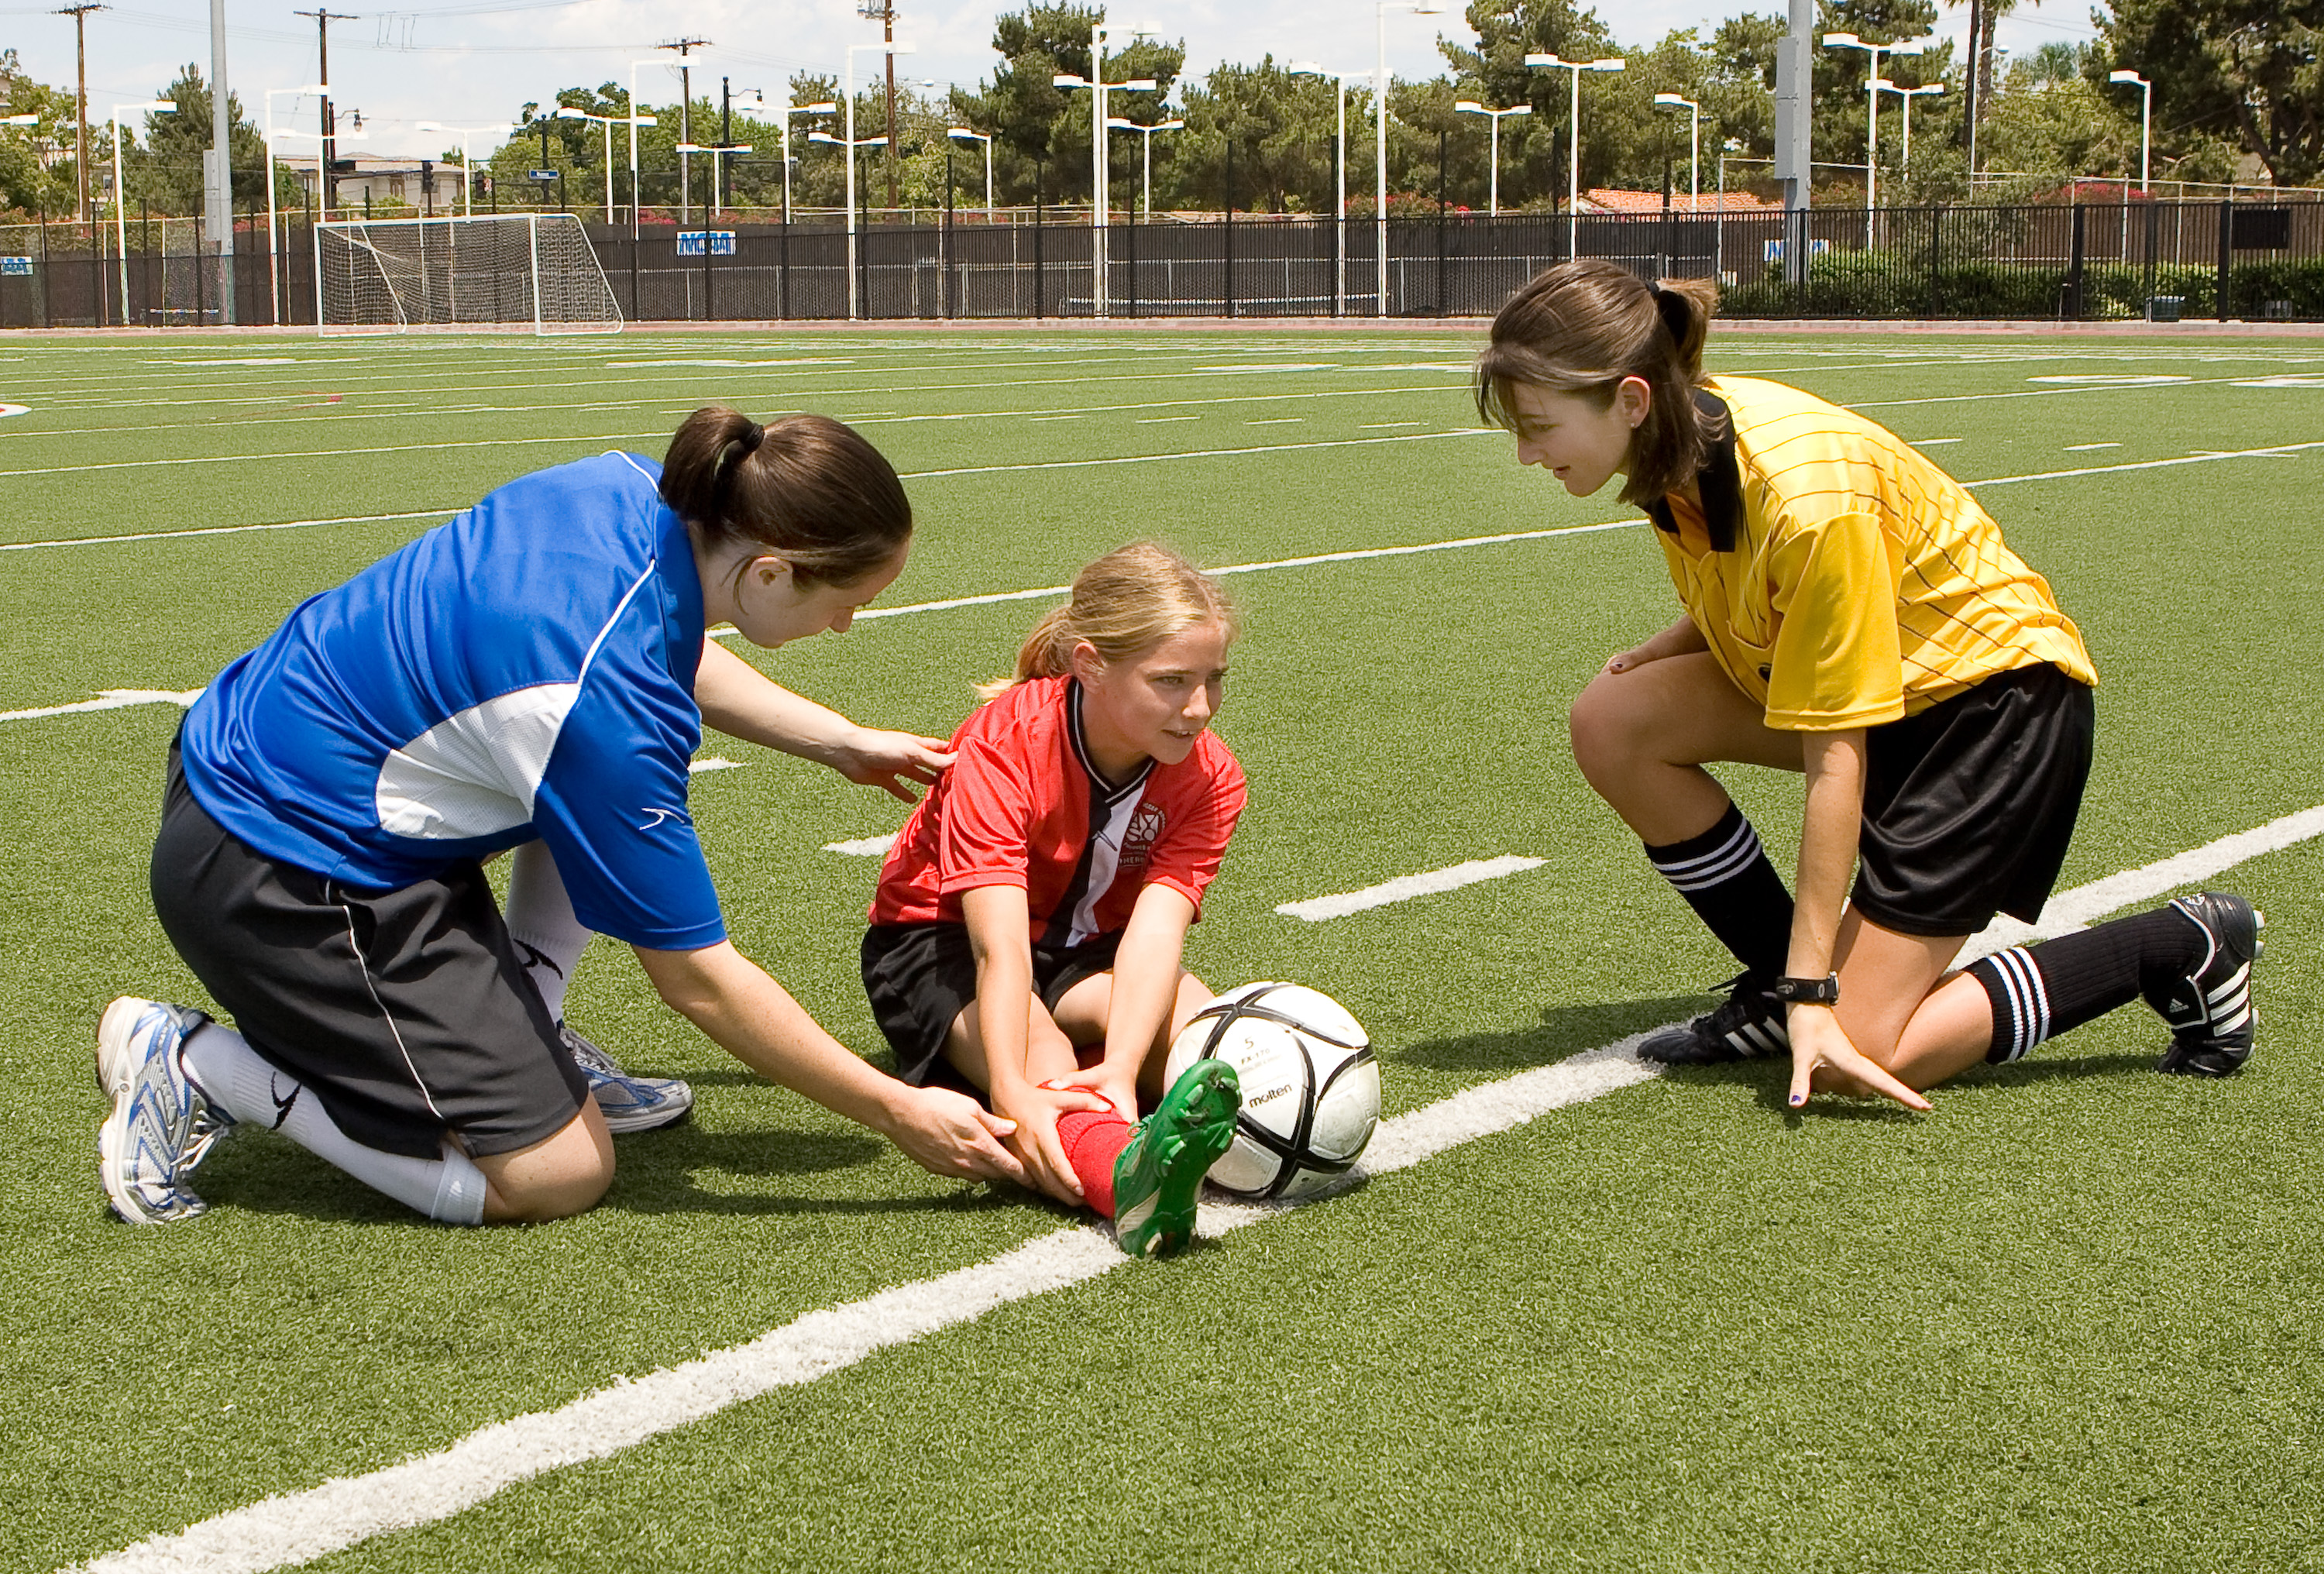
Injuries
When to stop: anytime / immediately
In younger players’ games, err on the side of caution. Stop sooner than later.
Always if you suspect a head injury
Notes:
Sequence:
If Referee stops play...
Referees quickly checks player.
If needed, Referee calls coach onto field.

Slide 73
Injuries
If player is injured and leaves field, with Referee’s permission:
Coach can decide if their team will play short (fewer than number normally on the field) until player returns to field, with Referee’s permission
or
Coach can substitute for injured player.
Notes:
If coach substitutes for the injured player, the injured player cannot re-enter the game until the next substitution opportunity: the next “quarter” or to replace an injured player.

Slide 74
Blood on player or uniform
Player must leave field until allowed to return, with Referee’s permission
Blood on body must be removed
Blood on clothing must be neutralized
Coach’s responsibility to address
Referee’s responsibility to verify
Notes:
Same applies to the referee.

Slide 75
Substitutions
Four opportunities:
About midway through first half
Halftime
About midway through second half
Injury (for injured player)
Notes:
Referee will need to keep track of time.
When the midpoint of a half is near, try to stop play at a natural stoppage (i.e., the ball goes out of play).
If a natural stoppage does not come soon enough, blow whistle to stop for the substitution break.

Slide 76
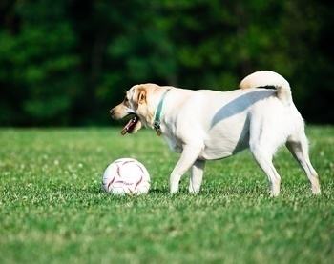
Outside interference
Unusual reasons for stopping play
Dog on the field
Extra ball or non-player on field
Ball hits referee and gives a team an advantage
Etc.

Slide 77
Weather safety
Thunder and lightning:
“Hear it, fear it; see it, flee it.”
If you see lightning or hear thunder, suspend the game until at least 30 minutes has passed since last lightning or thunder.
Hot days: Be sure players get adequate hydration opportunities.
Notes:
Hydration opportunities:
- Anytime during game, players can come to the touchline (stay on the field) and get water.
- During substitution breaks.
- At half-time.
- Additional breaks just for hydration can be added on unusually hot days.
Lengthen breaks and half-time as needed, but game must still end on time so the next game is not delayed.

Slide 78
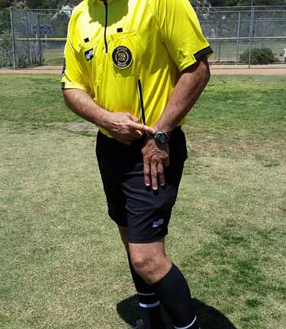
Time expires
At end of first half
At the end of game
Notes:
The referee is the official timekeeper.

Slide 80
When can the Referee stop play for an injury?
Anytime
or
Immediately

Slide 81
True or False
A player dribbling the ball steps over the line. The ball is out of play.
False
It’s the position of the ball
(not the player)
that determines whether the ball is
in play or not.

Slide 82
Is this ball IN or OUT of play?
IN
OUT
IN PLAY

Slide 83
Restarting the game

Slide 84
Restarting the game
Overview
Reason for stoppage | How to restart
Goal scored | Kick-off
Ball leaves field and was not a goal | Pass-in or throw-in, goal kick, or corner kick
Foul / technical offense | Indirect free kick
Injury or outside interference | Dropped ball
Notes:
Review quickly; do not explain details.

Slide 85
Pass-in
When ball passes out of play over a touchline, restart with pass-in (also called kick-in) (dribble-in also allowed).
Taken by opponents of team that last touched ball
Taken at touchline from about where ball left field
Regions may decide to use throw-in for 8U players.

Slide 86
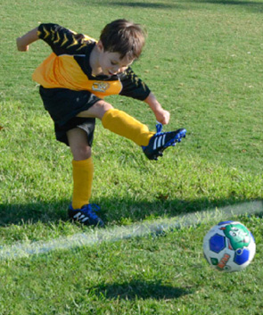
Pass-in
Opposing players must be at least 5 yards from point of pass-in.
Ball in play as soon as kicked and clearly moves. Player taking pass-in may instead dribble in.
Notes:
A pass and a kick are essentially the same. A dribble is a shortened version of a pass or kick.

Slide 87
Pass-in
Once in play, the ball may be played again by the same player taking the pass-in.
A goal may not be scored directly from a pass-in.
Notes:
Note that this is an exception to the normal “double touch“ prohibition.
A short pass or kick could easily turn into a dribble, thus multiple touches are allowed.

Slide 88
Throw-in
Regions may decide to use throw-in for 8U players.
When ball passes out of play over a touchline, restart with throw-in.
Taken by opponents of team that last touched ball
Taken from about where ball left field
Opposing players at least 5 yards from point of throw; can’t distract or impede thrower
Notes:
For simplicity and to be consistent with other restarts, opponents must be at least FIVE yards from point of throw. AYSO Reference Book: “Opponents should be 5 yards away from the ball on all restarts.”

Slide 89
Throw-in
At moment of delivering ball, thrower must:
Face field of play
Have part of each foot touching ground either on or behind touchline
Use both hands to deliver ball from behind and over head
Notes:
Doing throw-ins can be physically difficult for many 8U players. Referees should not be too picky. The point is to get the ball back into play.
A do-over, with guidance from the referee, may be allowed, but only one; otherwise, players spend too much time doing throw-ins instead of playing soccer. If the 2nd try does not go well, allow play to continue.
For best success, referee can give instructions before the throw.

Slide 90
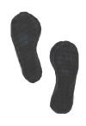
Throw-in: feet placement
On field
Touchline
Improper
Improper
Off field
Good
Good
Good
Good
Notes:
Referees should help players stand in the right place before the throw. Also tell them to keep their feet on the ground when they throw.
The point of the throw-in is to get the ball back into play, so don’t be too picky.

Slide 91
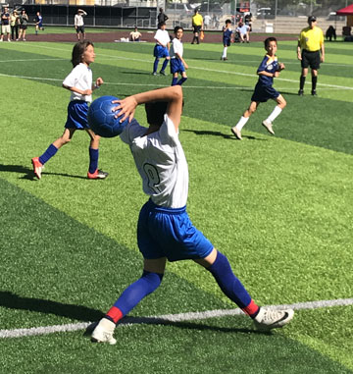
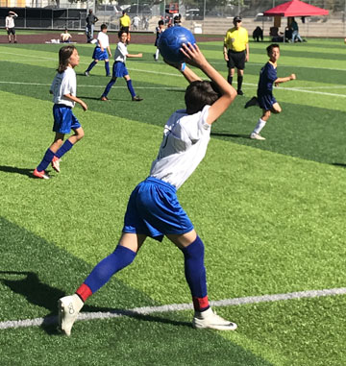
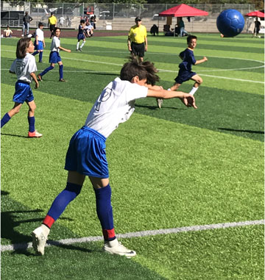
Throw-in

Slide 92
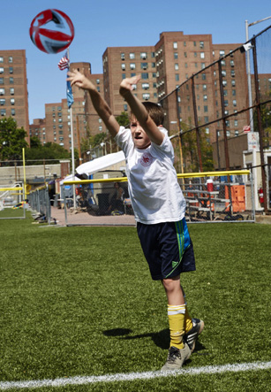
Throw-in
Ball in play as soon as released and any portion of it is over outside edge of touchline
Thrower may not touch ball second time until other player touches it
Goal may not be scored directly

Slide 93
Goal kick or corner kick
When whole ball passes over goal line and no goal is scored, play is restarted with either...
Goal kick for defending team, or
Corner kick for attacking team.
...depending on which team touched ball last.

Slide 94
Goal kick
Play is restarted with a goal kick when whole ball passes over goal line, last touched by attacker, and a goal is not scored.
Ball placed in general vicinity of goal
Opponents must at least 5 yards away

Slide 95
Goal kick
Ball in play when kicked and clearly moves
Kicker cannot touch ball second time until touched by another player
Can score goal directly against opponents

Slide 96
Corner kick
Play is restarted with a corner kick when whole ball passes over goal line, last touched by defender, and a goal is not scored.
Ball placed in vicinity of nearest corner
Opponents must be at least 5 yards from ball

Slide 97
Corner kick
Ball in play when kicked and clearly moves
Kicker cannot touch ball second time until touched by other player
Can score directly against opponents

Slide 98
Indirect free kick
When Referee stops play because of a foul or technical offense, restart is indirect free kick
ALL free kicks in 6–8U are indirect: cannot score directly.
No direct free kicks in 6–8U.
Taken from location of foul or technical offense.
But no closer than 5 yards from opposing team’s goal.
Notes:
“Technical offense” can be double touch or deliberate heading.
Explain what “indirect” means.

Slide 99
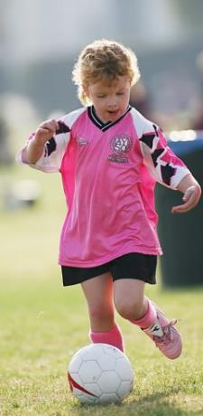
Indirect free kick
Opponents at least 5 yards away
Ball in play when kicked and clearly moves
Can be kicked in any direction
Kicker may not touch ball second time until it has touched another player

Slide 100
Dropped ball
To restart play for unusual but neutral reason.
Injury
Dog on the field
Stray ball or non-player on field
Ball hits referee and gives a team an advantage
Etc.

Slide 101
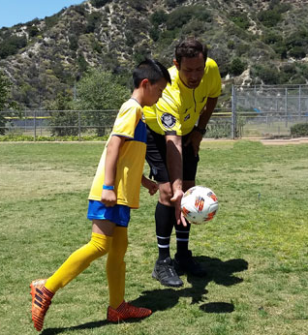
Dropped ball
Referee drops ball to one player on team that touched it last, where it last touched a player (or in rare cases, the Referee).
All other players at least 5 yards away from ball until ball touches the ground.
Notes:
For simplicity, round 4.5 yards to 5 yards.

Slide 102
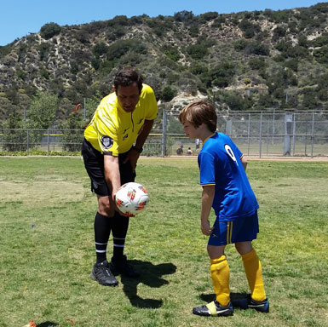
Dropped ball
Ball in play when it hits ground
If player kicks ball before it hits ground or if opponents run in too soon, ball is dropped again
Goal cannot be scored directly from dropped ball. Ball must touch another player first.

Slide 103
Flashback

Slide 104
A player is injured and leaves the field (with the Referee’s permission).
What are the coach’s substitution options?
The team can play short until the player returns to the field (with the Referee’s permission); or
A substitute can replace the injured player.

Slide 105
The ball goes completely over
the touchline,
last touched by an attacker.
What is the restart?
Pass-in for the defending team
(or throw-in for 8U if Region allows).

Slide 106
The ball goes completely over the goal line, last touched by a defender, and not a goal.
What is the restart?
Corner Kick

Slide 107
The ball goes completely over the goal line, last touched by an attacker, and not a goal.
What is the restart?
Goal Kick

Slide 108
Post-game duties

Slide 109
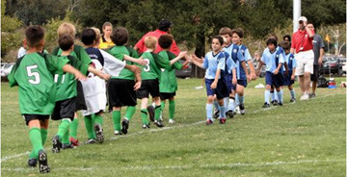
Post-game duties
Collect game ball and return to owner
Supervise team handshakes

Slide 110
Post-game duties
Complete lineup card
Complete any misconduct or incident report

Slide 111
Referee communication

Slide 112
Referee communication
Whistle, arm signals, and voice
Inexperienced players will not understand arm signals only or whistle only, so add verbal instruction.
Explain (briefly) reason for stopping play
Explain (briefly) how to restart play
Teach players to retrieve balls and place balls
Notes:
NOTE: this is general overview. See next slide for details about when to blow whistle and what the arm signals are.
Referees have three tools for communication: whistle, arm signals, and voice. Use all to help players know what to do. Verbal instruction is important because players are not familiar with what a whistle means, arm signals, reasons for stopping the game, and how to restart the game. You need to be their teacher. You’ll probably need to explain everything many times!
Ball management:
Teach players to retrieve the ball when it has left the field or when the ball needs to be placed in a certain location for a restart. Train the players to do this instead of doing it yourself.

Slide 113
Referee signals
Situation | Whistle? | Arm signal, restart, and comments
Kick-off | YES | Point arm horizontally toward goal being attacked by the team taking the kick.
Ball leaves field (not a goal) | NO, if obvious | Pass-in or throw-in: point arm 45 degrees up towards goal being attacked by the team taking the throw-in. Goal kick: point arm 45 degrees horizontal or slightly downwards toward goal area of team taking the kick. Corner kick: point arm 45 degrees up towards corner where kick is to be taken (corner nearest to where ball went out).
Notes:
See handout.

Slide 114
Referee signals
Situation | Whistle? | Arm signal, restart, and comments
Goal scored | NO, if obvious | Point arm horizontally towards center circle. Restart with kick-off.
Foul / technical offense | YES | Point arm horizontally toward goal being attacked by the team taking the free kick. Restart with indirect free kick.
Injury (not associated with a foul), outside interference | YES | No arm signal. Restart with dropped ball.

Slide 115
Referee signals
Situation | Whistle? | Arm signal, restart, and comments
Substitution break | YES | Stop play for break with whistle. Restart based on reason play stopped, with whistle.
End of half | YES | Whistle (2 tweets for end of 1st half; 3 tweets for end of 2nd half) and point arm horizontally towards center mark.
No whistle for the restart unless after a longer stoppage in game, like after injury or after substitution break.

Slide 116
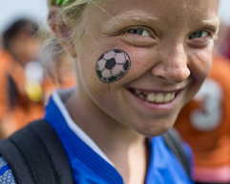
In AYSO, it’s about more than the game!

Slide 117
Questions?
Thank you for volunteering!

